Slide 1
Monetary and fiscal policy
HSPM 714 J50
Fall 2013

Slide 2
Depressions can happen
When people don’t spend money
  Enough money to buy what people can produce

Slide 3
Why don’t people spend money?
… if they don’t have any
… if they have some but want to save it for later

Slide 4
What can …
Baby sitting coop committee do?
Government do?
Give out certificates
Give out money

Slide 5
Moral problem with giving out money
Resentment
http://www.youtube.com/watch?v=zp-Jw-5Kx8k

Slide 6
Moral problem work-arounds
Give to deserving
  Current fight over food stamps
  “moochers”
Buy goods and services
Make it easier to borrow

Slide 7
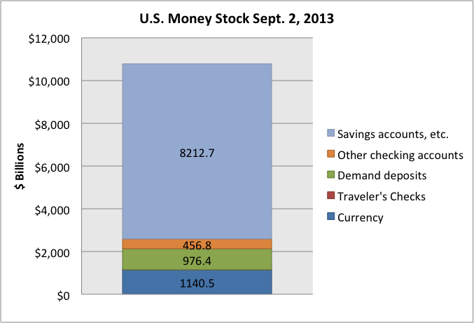
Most money is credit

Slide 8
Were it not for government guarantees …
… much of the top parts of that chart could disappear in a default crisis
  Leaving people with way less money to spend
    Which happened during the 1930s, and is why we have the FDIC, etc.

Slide 9
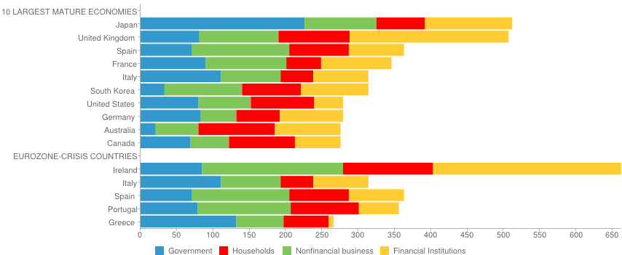
Much of spending is borrowed money
http://www.gfmag.com/tools/global-database/economic-data/11855-total-debt-to-gdp.html - axzz2gcYsQmBz

Slide 10
Can falling prices solve depression?
Debt overhang
Falling prices means more defaults
  As real value of owed money increases
Anyway, wages are sticky downward
  Wage cuts bad for morale, productivity

Slide 11
Banking crisis
When there are defaults
Credit contracts
Money disappears, or hides

Slide 12
Monetary policy to alleviate depression
Federal Reserve lends at low interest
  To U.S. Treasury, by buying T-bonds
  To big banks, by direct lending
  To large firms, by buying bonds
    “quantitative easing”
Supposed to trickle down to
  Small business
  Home mortgages

Slide 13
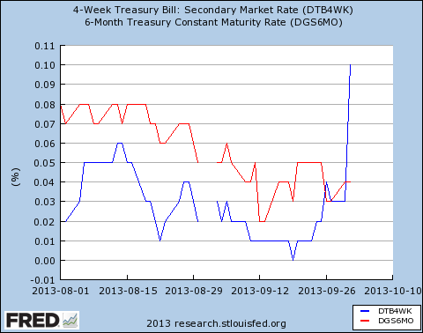
Liquidity trap
When interest rates go to 0%
But people still aren’t spending enough

Slide 14
Inflation and the money stock
Prices – determined by supply and demand
Supply and demand are flows
Having a bigger or smaller money stock affects prices only by affecting the flow of demand (spending)
In liquidity trap, more money stock does not mean more demand flow

Slide 15
Fiscal policy
Federal government spending
  Tax and spend
  Borrow and spend
    Borrow from Fed and spend
      “print money”

Slide 16
The multiplier
Spending gives people money, which they can spend
Total spending increase =
  what government spends plus
  what people government buys from spend plus
  what people that those people buy from spend,
  etc.

Slide 17
How big is the multiplier?
Depends on where money comes from
Borrow from Fed and spend
  Biggest multiplier
Borrow from public or raise taxes
  Smaller multiplier, but not 0
    Because some of that is less flow to savings

Slide 18
In progress …
WWII government spending
Stimulus act of 2009 too small
when spending diminishes
  Tax revenues shrink
  States can’t borrow, must cut spending
Total government spending hasn’t grown like after 2001.
Debt held by public level as % of GDP for next decade.

Slide 19
Government not a business
Starbucks example

Slide 20
Fundamentalism
Not just in religion
In politics
In economics
Response to uncertainty

